Slide 1
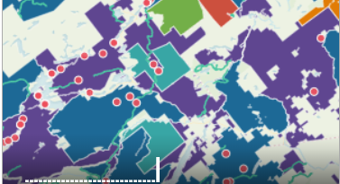

Intro to Web GIS
GIS in the Sciences
ERTH 4750
Steve Signell, Instructor
Friday, March 30, 2018

Slide 2
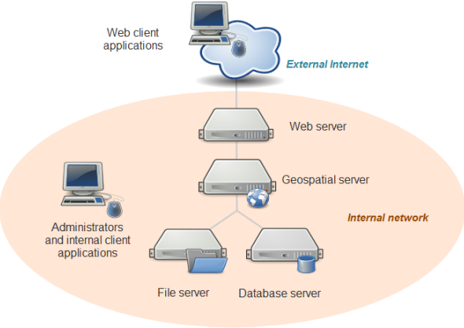
Web Mapping
What is Web Mapping?
the process of using the maps delivered by geographic information systems (GIS) in the World Wide Web (Wikipedia)
A web map on the World Wide Web is both served and consumed.
More than just web cartography, it is a service by which consumers may choose what the map will show.
Server Side
Client Side
Source: https://en.wikipedia.org/wiki/Web_mapping

Slide 3
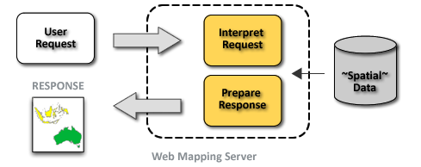
Interactive Maps
Interactive Maps
Browser is your GUI instead of QGIS
User-controlled maps are called Interactive Maps.
Zoom
Pan
Click
Hover
Etc.
Sometimes these actions are handled on the Client Side, sometimes on the Server Side
Client side: all the data is given to the client up front and the work is done in the browser.
Server Side: data not all loaded at once; map service repeatedly accessed to fetch data as users interact.

Slide 4
Some Web Mapping Services
Web Map Tile Services (WMS/WMTS)
Web Feature Services (WFS)
Application Program Interfaces (APIs)
All ways of rendering and or delivering geospatial data

Slide 5
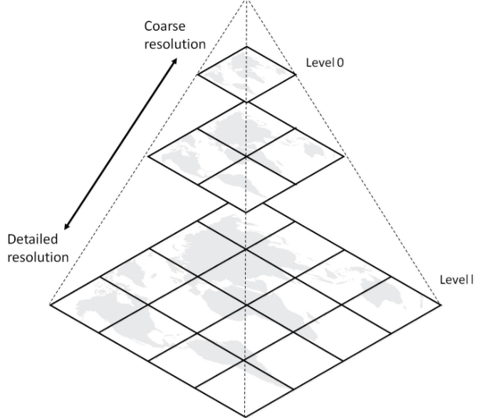
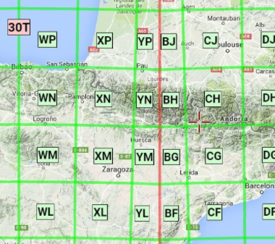
Web Map Tile Services
Web Map Tile Service (WMS or WMTS)
Geospatial Server accepts a request from the client’s desktop GIS or browser and produces a series of one or more jpg or png images that get returned to client.
Data is NOT included- no attribute table returned
A good way to render rasters and large vector datasets.
Can’t change the symbology– determined by the server
When you click on the map, it sends a request to the Geospatial server to get retrieve the info for that set of coordinates.
Client or Server side?

Slide 6
Web Feature Services
Web FeatureService (WFS)
Geospatial Server delivers the entire vector dataset including attributes.
Once the data is delivered, geospatial server no longer needed.
Client or Server side?

Slide 7
Application Programming Interfaces (APIs)
API
Exposes data from the server to the web in a way that is easy for web sites to consume
Data often accessed via URL (a ‘RESTFUL’ API)
https://adirondackatlas.org/api/v1/points.php?keyword=wine
https://adirondackatlas.org/api/v1/points.php?keyword=beer
https://data.ny.gov/ is an good example of a site where all the data can be accessed via RESTFUL API
Client or Server side?
Demo: Adirondack Atlas

Slide 8
Technology Infrastructure
Internal Client Application
File Server
Database Server
Geospatial Server
Web Server
Browser

Slide 9
Web Mapping Demo
Adirondack Atlas Example
PostGIS
Geoserver
Mapbox
Apache
Notes:
Visit Adirondack atlas main page
Visit geoserver →layer preview
Mapbox

Slide 10
For Next Class
Homework for next Tuesday
Complete Lab 16 assignment and send me the link to your published Carto Map
With your group, create a Carto Map and/or a QGIS map project showing 3-4 of your most promising datasets. Save the QGIS project in your GitHub Repo and/or send me a link to your published Carto map.

